Slide 1

Automatic Storage Management

Slide 2
Automatic Storage Management
  Высокопроизводительная кластерная файловая система
  Позволяет управлять файлами данных Oracle
  Автоматическое перераспределение
  данных между дисками
  Встроенная система зеркалирования
  дисков
Application
Database
File
system
ASM
Volume
manager
Operating system
Notes:
Oracle Database 10g: Administration Workshop II 12-<number>
Automatic Storage Management: Review
Automatic Storage Management (ASM) provides a vertical integration of the file system and the volume manager that is specifically built for the Oracle database files. ASM can provide management for single SMP machines, or across multiple nodes of a cluster for Oracle Real Application Clusters (RAC) support.
ASM distributes I/O load across all available resources to optimize performance while removing the need for manual I/O tuning. ASM helps DBAs to manage a dynamic database environment by allowing them to increase the database size without having to shut down the database to adjust the storage allocation.
ASM can maintain redundant copies of data to provide fault tolerance, or it can be built on top of vendor-supplied reliable storage mechanisms. Data management is done by selecting the desired reliability and performance characteristics for classes of data rather than with human interaction on a per file basis.
ASM capabilities save DBAs’ time by automating manual storage and thereby increasing their ability to manage larger databases and more of them with increased efficiency.

Slide 3
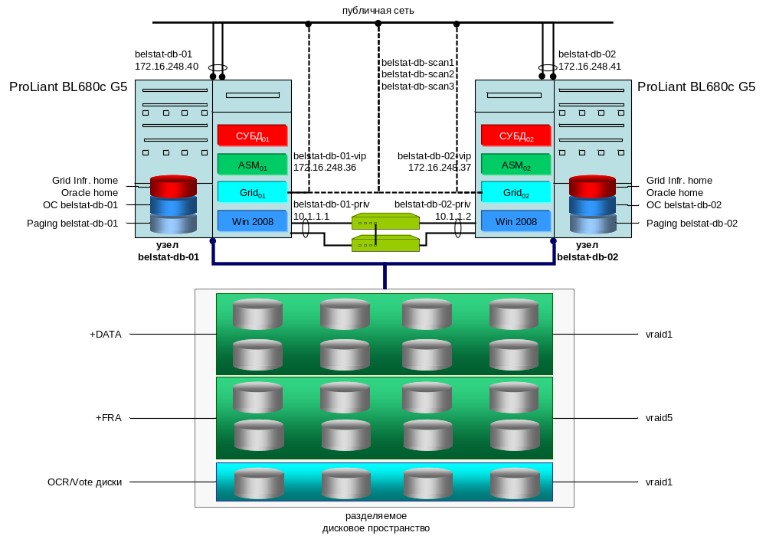

Cluster общая архитектура

Slide 4
ASM Общая архитектура
DB instance
SID=sales
ASM
instance
SID=asm
RBAL
DBW0
ASMB
FG
ARB0
…
RBAL
ARBA
ASM disks
ASM disks
ASM disks
ASM disks
ASM disks
ASM disks
ASM disk group 1
ASM disk group 2
Notes:
Oracle Database 10g: Administration Workshop II 12-<number>
ASM General Architecture
To use ASM, you must start a special instance, called an ASM instance, before you start your database instance. ASM instances do not mount databases, instead they manage the metadata needed to make ASM files available to ordinary database instances. Both ASM instances and database instances have access to some common set of disks called disk groups. Database instances access the contents of ASM files directly, communicating with an ASM instance only to get information about the layout of these files.
An ASM instance contains two new background processes. One coordinates rebalance activity for disk groups. It is called RBAL. The second one performs the actual rebalance AU movements. There can be many of these at a time, and they are called ARB0, ARB1, and so forth. An ASM instance also has some of the same background processes as a database instance, including SMON, PMON, LGWR, DBWR, and CKPT.

Slide 5
ASM управление
  Создание ASM инстанса
  Установка параметров
  Запуск ASM инстанса
  Управление ASM инстансом
  Остановка ASM инстанса
Notes:
Oracle Database 10g: Administration Workshop II 12-<number>

Slide 6
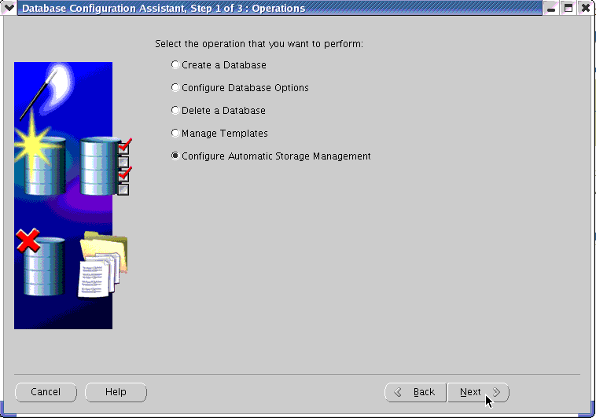
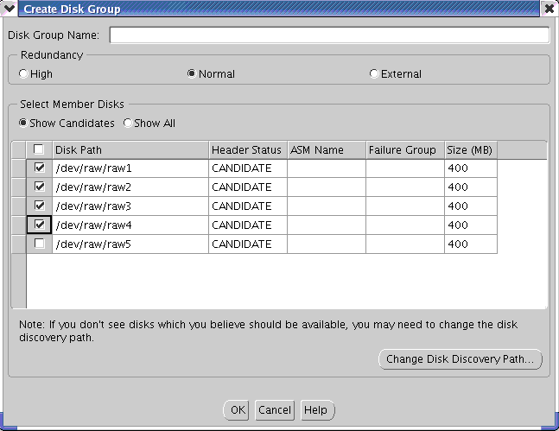
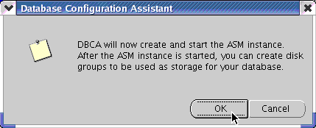
Создание ASM инстанса
Notes:
Oracle Database 10g: Administration Workshop II 12-<number>
Creating an ASM Instance
You create an ASM instance by running the Database Configuration Assistant (DBCA). On the first screen, choose the option to Configure Automatic Storage Management, and follow the steps. The ASM instance is created and started for you. Then you are guided through the process of defining disk groups for the instance.
As part of the ASM instance creation process, the DBCA automatically creates an entry into the oratab file. This entry is used for discovery purposes. On the Windows platform where a services mechanism is used, the DBCA automatically creates an Oracle Service and the appropriate registry entry to facilitate the discovery of ASM instances.
When an ASM instance is configured, the DBCA creates an ASM instance parameter file and an ASM instance password file.
If you were to first create an ASM-enabled database, the DBCA determines whether an ASM instance already exists on your host. If ASM instance discovery returns an empty list, the DBCA creates a new ASM instance.

Slide 7
ASM Instance Initialization Parameters
INSTANCE_TYPE = ASM
DB_UNIQUE_NAME = +ASM
ASM_POWER_LIMIT = 1
ASM_DISKSTRING = '/dev/rdsk/*s2', '/dev/rdsk/c1*'
ASM_DISKGROUPS = dgroupA, dgroupB
LARGE_POOL_SIZE = 8MB
Notes:
Oracle Database 10g: Administration Workshop II 12-<number>
ASM Instance Initialization Parameters
INSTANCE_TYPE should be set to ASM for ASM instances.
DB_UNIQUE_NAME specifies the service provider name for which this ASM instance manages disk groups. The default value of +ASM must be modified only if you run multiple ASM instances on the same node.
ASM_POWER_LIMIT controls the speed for a rebalance operation. Values range from 1 through 11, with 11 being the fastest. If omitted, this value defaults to 1. The number of slaves is derived from the parallelization level specified in a manual rebalance command (POWER), or by the ASM_POWER_LIMIT parameter.
ASM_DISKSTRING is an operating system–dependent value used by ASM to limit the set of disks considered for discovery.
ASM_DISK_GROUPS is the list of names of disk groups to be mounted by an ASM instance at startup, or when the ALTER DISKGROUP ALL MOUNT command is used.
The INSTANCE_TYPE parameter is the only parameter that you must define. All other ASM parameters have default values that are suitable for most environments.
Note: If the ASM environment has been created using the command line instead of EM, then the disk groups must be created before they can be mounted.

Slide 8
Database Instance Parameter Changes
…
INSTANCE_TYPE = RDBMS
LOG_ARCHIVE_FORMAT
DB_BLOCK_SIZE
DB_CREATE_ONLINE_LOG_DEST_n
DB_CREATE_FILE_DEST
DB_RECOVERY_FILE_DEST
CONTROL_FILES
LOG_ARCHIVE_DEST_n
LOG_ARCHIVE_DEST
STANDBY_ARCHIVE_DEST
LARGE_POOL_SIZE = 8MB
…
Notes:
Oracle Database 10g: Administration Workshop II 12-<number>
Database Instance Parameter Changes
INSTANCE_TYPE defaults to RDBMS and specifies that this instance is an RDBMS instance.
LOG_ARCHIVE_FORMAT is ignored if LOG_ARCHIVE_DEST is set to an incomplete ASM file name, such as +dGroupA. If LOG_ARCHIVE_DEST is set to an ASM directory (for example, +dGroupA/myarchlogdir/), then LOG_ARCHIVE_FORMAT is used and the files are non-OMF. Unique file names for archived logs are automatically created by the Oracle database.
The following parameters accept the multifile creation context form of ASM file names as a destination:
DB_CREATE_ONLINE_LOG_DEST_n
DB_CREATE_FILE_DEST
DB_RECOVERY_FILE_DEST
CONTROL_FILES
LOG_ARCHIVE_DEST_n
LOG_ARCHIVE_DEST
STANDBY_ARCHIVE_DEST
Note: Because allocation unit maps for ASM files are allocated from the LARGE_POOL, you must set the LARGE_POOL_SIZE initialization parameter to at least 8 MB, preferably higher.

Slide 9
Запуск ASM инстанса
$ export ORACLE_SID='+ASM'
$ sqlplus /nolog
SQL> CONNECT / AS sysdba
Connected to an idle instance.
SQL> STARTUP;
ASM instance started
Total System Global Area 147936196 bytes
Fixed Size 324548 bytes
Variable Size 96468992 bytes
Database Buffers 50331648 bytes
Redo Buffers 811008 bytes
ASM diskgroups mounted
Notes:
Oracle Database 10g: Administration Workshop II 12-<number>
Starting Up an ASM Instance
ASM instances are started similarly to database instances except that the initialization parameter file contains an entry like INSTANCE_TYPE=ASM. When this parameter is set to the value ASM, it informs the Oracle executable that an ASM instance is starting, not a database instance. Also, the ORACLE_SID variable must be set to the ASM instance name. When the ASM instance starts up, the mount stage attempts to mount the disk groups specified by the ASM_DISKGROUPS initialization parameter rather than mounting a database, as is done with non-ASM instances.
Other STARTUP clauses have comparable interpretation for ASM instances as they do for database instances. OPEN is invalid for an ASM instance. NOMOUNT starts up the ASM instance without mounting any disk group.

Slide 10

Доступ к ASM
AS SYSDBA
ASM
instance
AS SYSOPER
Все операции
Частичные операции
Disk group
Disk group
Storage system
Notes:
Oracle Database 10g: Administration Workshop II 12-<number>
Accessing an ASM Instance
ASM instances do not have a data dictionary, so the only way to connect to one is by using OS authentication, that is, SYSDBA or SYSOPER. To connect remotely, a password file must be used. Normally, the SYSDBA privilege is granted through the use of an operating system group. On UNIX, this is typically the dba group. By default, members of the dba group have SYSDBA privilege on all instances on the node, including the ASM instance. Users who connect to the ASM instance with the SYSDBA privilege have administrative access to all disk groups in the system. The SYSOPER privilege is supported in ASM instances and limits the set of allowable SQL commands to the minimum required for basic operation of an already configured system.

Slide 11
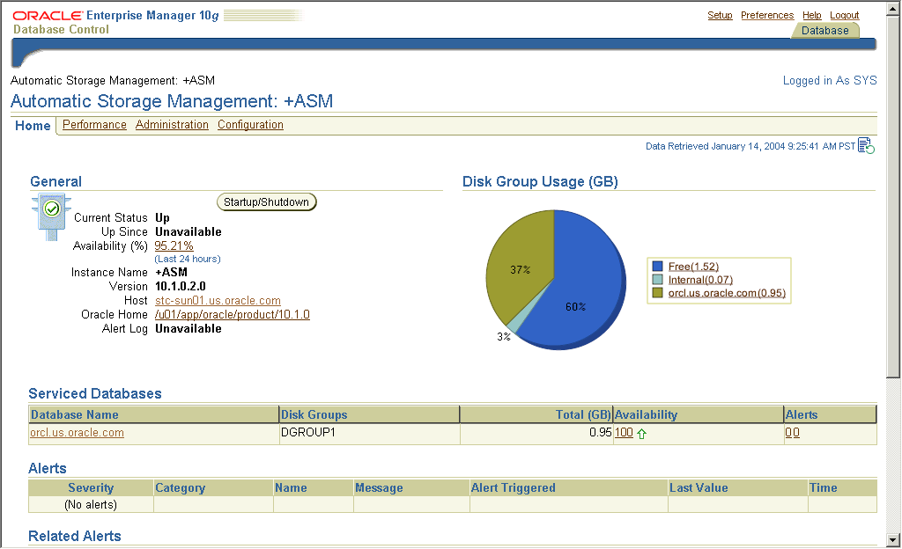
ASM Home Page
Notes:
Oracle Database 10g: Administration Workshop II 12-<number>
ASM Home Page
Enterprise Manager provides a user-friendly graphical interface to the Oracle database management, administration, and monitoring tasks. Oracle Database 10g extends the existing functionality to transparently support the management, administration, and monitoring of Oracle databases that use ASM storage. It also adds support for the new management tasks required for administration of ASM instance and ASM disk groups.
The ASM home page shows the status of the ASM instance along with the metrics and alerts generated by the collection mechanisms. It also provides the startup and shutdown functionality. Clicking the Alert link takes the user to an alert details page. The DiskGroup Usage chart shows space used by each client database along with free space.

Slide 12
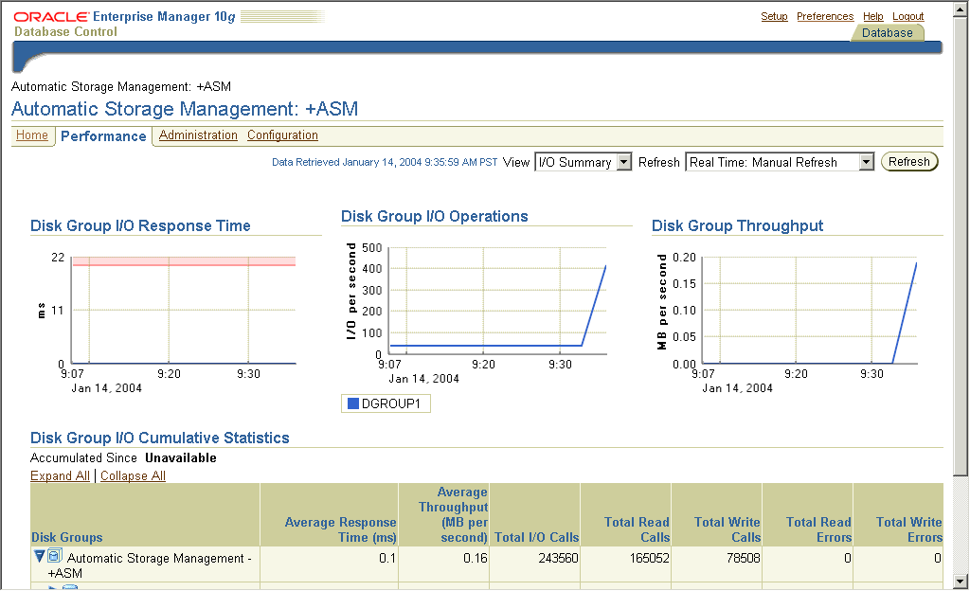
ASM Performance Page
Notes:
Oracle Database 10g: Administration Workshop II 12-<number>
ASM Performance Page
The Performance tab of the Automatic Storage Management page shows the I/O response time and throughput for each disk group. You can further drill down to view disk-level performance metrics.

Slide 13
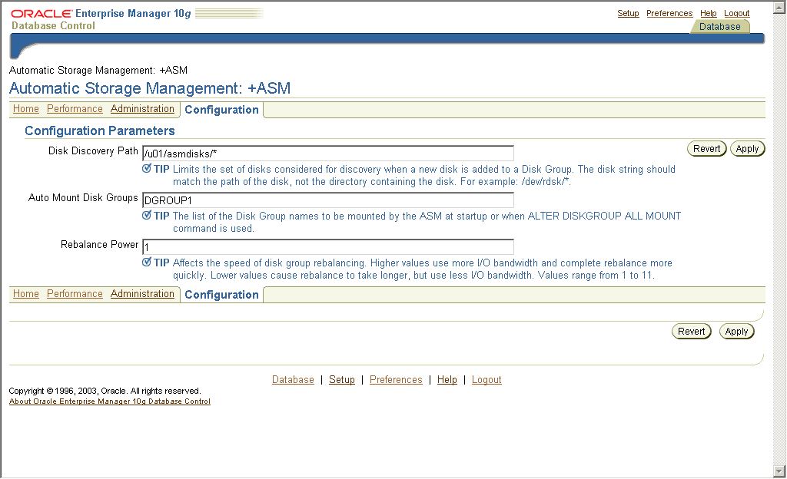
ASM Configuration Page
Notes:
Oracle Database 10g: Administration Workshop II 12-<number>
ASM Configuration Page
The Configuration tab of the Automatic Storage Management page enables you to view or modify the initialization parameters of the ASM instance.

Slide 14


Выключение ASM инстанса
Database instance A
Database instance B
2
ASM instance
3
SHUTDOWN NORMAL
1
1
Notes:
Oracle Database 10g: Administration Workshop II 12-<number>
Shutting Down an ASM Instance
When you attempt to shutdown an ASM instance in the NORMAL, IMMEDIATE, or TRANSACTIONAL modes, it will only succeed if there are no database instances connected to the ASM instance. If there is at least one connected instance, you will receive the following error:
ORA-15097: cannot SHUTDOWN ASM instance with connected RDBMS instance
If you perform a SHUTDOWN ABORT on the ASM instance, it will shutdown, and it will require recovery at the time of the next startup. Any connected database instances will also eventually shutdown, reporting the following error:
ORA-15064: communication failure with ASM instance
In a single ASM instance configuration, if the ASM instance fails while disk groups are open for update, then after the ASM instance reinitializes, it reads the disk group’s log and recovers all transient changes. With multiple ASM instances sharing disk groups, if one ASM instance fails, another ASM instance automatically recovers transient ASM metadata changes caused by the failed instance. The failure of a database instance does not affect ASM instances. The ASM instance should be started automatically whenever the host is rebooted. ASM instance is expected to use the automatic startup mechanism supported by the underlying operating system. Note that file system failure usually crashes a node.

Slide 15
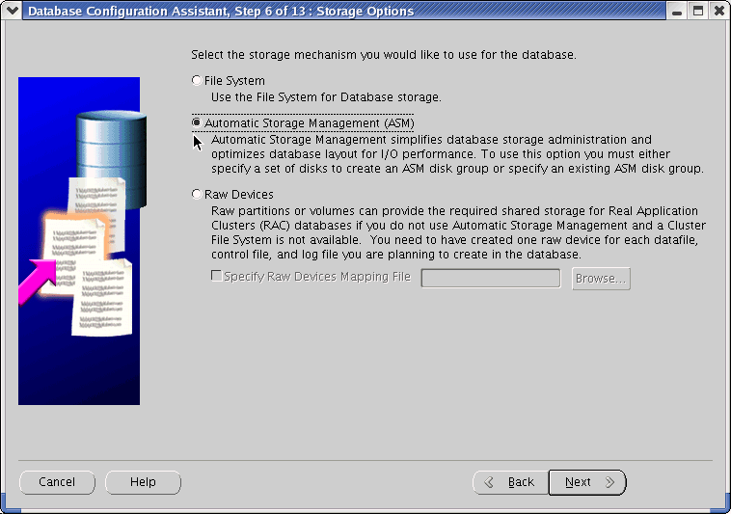
DBCA and Storage Options
Notes:
Oracle Database 10g: Administration Workshop II 12-<number>
DBCA and Storage Options
In order to support ASM as a storage option, this screen appears in the Database Configuration Assistant (DBCA) when creating a database. This allows you to choose the storage options: file system, ASM, or raw devices.

Slide 16
ASM Storage: Concepts
Database
ASM
disk group
Tablespace
Data file
ASM file
Segment
ASM disk
Extent
File system
file
or
raw device
Allocation unit
(AU)
Oracle data
block
Physical
block
Notes:
Oracle Database 10g: Administration Workshop II 12-<number>
ASM Storage: Concepts
ASM does not eliminate any preexisting database functionality. Existing databases are able to operate as they always have. You can create new files as ASM files and leave existing files to be administered in the old way, or you can eventually migrate them to ASM.
The diagram depicts the relationships that exist between the various storage components inside an Oracle database with ASM available. The left and middle parts of the diagram show the relationships that exist in previous releases. On the right are the new concepts introduced by ASM.
Database files can be stored as ASM files. At the top of the new hierarchy are ASM disk groups. Any single ASM file is contained in only one disk group. However, a disk group may contain files belonging to several databases, and a single database may use storage from multiple disk groups. As you can see, one disk group is made up of multiple ASM disks, and each ASM disk belongs to only one disk group. ASM files are always spread across all the ASM disks in the disk group. ASM disks are partitioned in allocation units (AU) of one megabyte each. An allocation unit is the smallest contiguous disk space that ASM allocates. ASM does not allow an Oracle block to be split across allocation units.
Note: This graphic deals with only one type of ASM file: data file. However, ASM can be used to store other database file types.

Slide 17
Стек технологий
Файловая система
ASM
Tables
Tables
Tablespace
Tablespace
Oracle
ASM
Files
0010 0010 0010 0010 0010
0010 0010 0010 0010 0010
Files
File System
File System
Logical Vol
Logical Vol
Disks
Disk Group
“Лучший способ снизить стоимость управления – уменьшить сложность”

Slide 18

ASM Дисковые группы
  Наборы дисков управляются как логические единицы
  Распределение информации по всем дискам группы
ASM
instance
Disk group
Notes:
Oracle Database 10g: Administration Workshop II 12-<number>
ASM Disk Groups
A disk group is a collection of disks managed as a logical unit. Storage is added and removed from disk groups in units of ASM disks. Every ASM disk has an ASM disk name, which is a name common to all nodes in a cluster. The ASM disk name abstraction is required because different hosts can use different names to refer to the same disk.
ASM always spreads files evenly in 1 MB allocation unit (AU) chunks across all the disks in a disk group. This is called coarse striping. That way, ASM eliminates the need for manual disk tuning. However, disks in a disk group should have similar size and performance characteristics to obtain optimal I/O. For most installations there is only a small number of disk groups. For instance, one disk group for a work area, and one for a recovery area. For files, such as log files, that require low latency, ASM provides fine-grained (128 KB) striping. Fine striping stripes each AU. Fine striping breaks up medium-sized I/O operations into multiple smaller I/O operations that execute in parallel. While the number of files and disks increase, you only have to manage a constant number of disk groups. From a database perspective, disk groups can be specified as the default location for files created in the database.
Note: Each disk group is self-describing, containing its own file directory and disk directory.

Slide 19


ASM - Динамическая балансировка
Автоматическая балансировка «на лету» при любых изменениях конфигурации
Disk Group
Notes:
Если администратор БД решил увеличить размер дискового пространства для БД Oracle, он может просто подключить новый диск к системе и выполнить команду добавления этого диска в группу. После этого Oracle сам переместит часть данных на вновь появившееся пространство, чтобы сбалансировать нагрузку.

Slide 20
ASM - Динамическая балансировка
Автоматическая балансировка «на лету» при любых изменениях конфигурации
Данные автоматически переносятся пропорционально на новые носители
Disk Group

Slide 21
ASM - Динамическая балансировка
Автоматическая балансировка «на лету» при любых изменениях конфигурации
Данные автоматически переносятся пропорционально на новые носители
Никакого ручного тюнинга I/O
Disk Group

Slide 22
ASM - Динамическая балансировка
Автоматическая балансировка «на лету» при любых изменениях конфигурации
Данные автоматически переносятся пропорционально на новые носители
Online миграция на новый storage
Disk Group
Notes:
ASM позволяет смигрировать файлы базы данных на новое устройство хранения информации не останавливая БД.
Мы просто добавляем новую группу дисков в существующую ASM дисковую группу
И удаляем старые диски одновременно в одной alter diskgroup ASM команде.

Slide 23
ASM - Динамическая балансировка
Автоматическая балансировка «на лету» при любых изменениях конфигурации
Данные автоматически переносятся пропорционально на новые носители
Online миграция на новый storage
Disk Group
Notes:
Если это будут разные команды, то балансировка данных будет выполнена дважды.

Slide 24
ASM - Динамическая балансировка
Автоматическая балансировка «на лету» при любых изменениях конфигурации
Данные автоматически переносятся пропорционально на новые носители
Online миграция на новый storage
Disk Group
Notes:
Ждём, когда завершится балансировка v$asm_operation

Slide 25
ASM - Динамическая балансировка
Автоматическая балансировка «на лету» при любых изменениях конфигурации
Данные автоматически переносятся пропорционально на новые носители
Online миграция на новый storage
Disk Group
Notes:
И отключаем старые диски.

Slide 26

Зекалирование дисковых групп
  Внешнее резервирование
  (External redundancy)
  Обычное резервирование
  (Normal redundancy)
  Надежное резервирование
  (High redundancy)
Notes:
Oracle Database 10g: Administration Workshop II 12-<number>
Disk Group Mirroring
ASM has three disk group types that support different types of mirroring:
External redundancy: Do not provide mirroring. Use an external-redundancy disk group if you use hardware mirroring or if you can tolerate data loss as the result of a disk failure. Failure groups are not used with these types of disk groups.
Normal-redundancy: Support two-way mirroring
High-redundancy: Provide triple mirroring
ASM does not mirror disks; rather, it mirrors allocation units. As a result, you need only spare capacity in your disk group. When a disk fails, ASM automatically reconstructs the contents of the failed disk on the surviving disks in the disk group by reading the mirrored contents from the surviving disks. This spreads the I/O hit from a disk failure across several disks.
When ASM allocates a primary AU of a file to one disk in a disk group, it allocates a mirror copy of that AU to another disk in the disk group. Primary AUs on a given disk can have their mirror copies on one of several partner disks in the disk group. ASM ensures that a primary AU and its mirror copy never reside in the same failure group. If you define failure groups for your disk group, ASM can tolerate the simultaneous failure of multiple disks in a single failure group.

Slide 27
Создание дисковой группы
Создать дисковую группу (data1) с избыточностью, определяемой устройством хранения (external), использующей диск /dev/raw/raw1.
create diskgroup data1
external redundancy
disk '/dev/raw/raw1';
Создать дисковую группу (data2) с избыточностью, определяемой устройством хранения (external), использующей диски /dev/raw/raw2 и /dev/raw/raw3.
create diskgroup data2
external redundancy
disk '/dev/raw/raw2',
'/dev/raw/raw3';
Создать дисковую группу (data3) с избыточностью, управляемой ASM (зеркалирование) (normal), использующей диски /dev/raw/raw4 и /dev/raw/raw6.
create diskgroup data3
normal redundancy
failgroup controller1 disk '/dev/raw/raw4'
failgroup controller2 disk '/dev/raw/raw6';

Slide 28
Managing Disk Groups
CREATE DISKGROUP
ASM
instance
DROP DISKGROUP
Database
instance
ALTER DISKGROUP
Notes:
Oracle Database 10g: Administration Workshop II 12-<number>
Managing Disk Groups
The main goal of an ASM instance is to manage disk groups and protect their data. ASM instances also communicate file layout to database instances. In this way, database instances can directly access files stored in disk groups.
There are several new disk group administrative commands. They all require the SYSDBA privilege and must be issued from an ASM instance.
You can add new disk groups. You can also modify existing disk groups to add new disks, remove existing ones, and perform many other operations. You can remove existing disk groups.

Slide 29
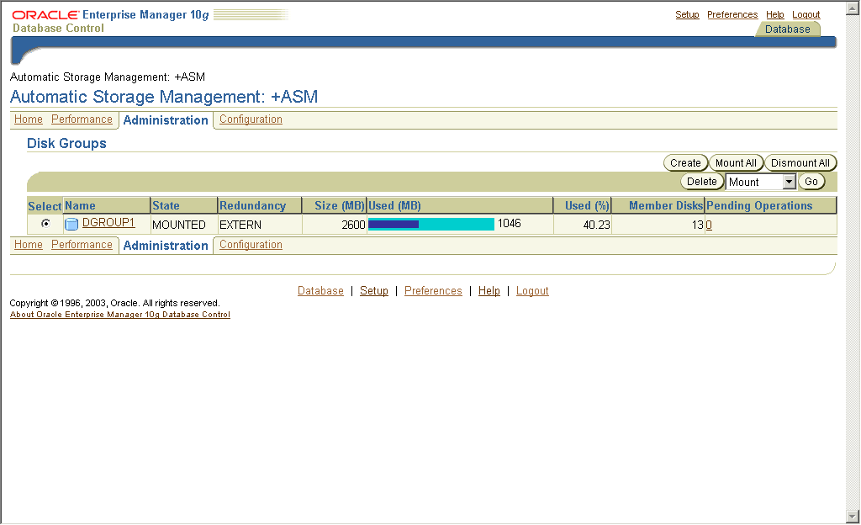
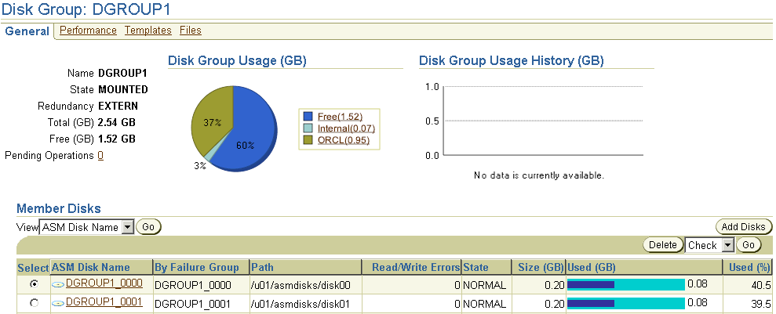
ASM Administration Page
Notes:
Oracle Database 10g: Administration Workshop II 12-<number>
ASM Administration Page
When you click the Administration tabbed page of the Automatic Storage Management page, you can see the disk groups listed in the V$ASM_DISKGROUP view. From here, you can create, edit, or drop a disk group. You can also perform disk group operations such as mount, dismount, rebalance, check, and repair on a selected disk group.

Slide 30
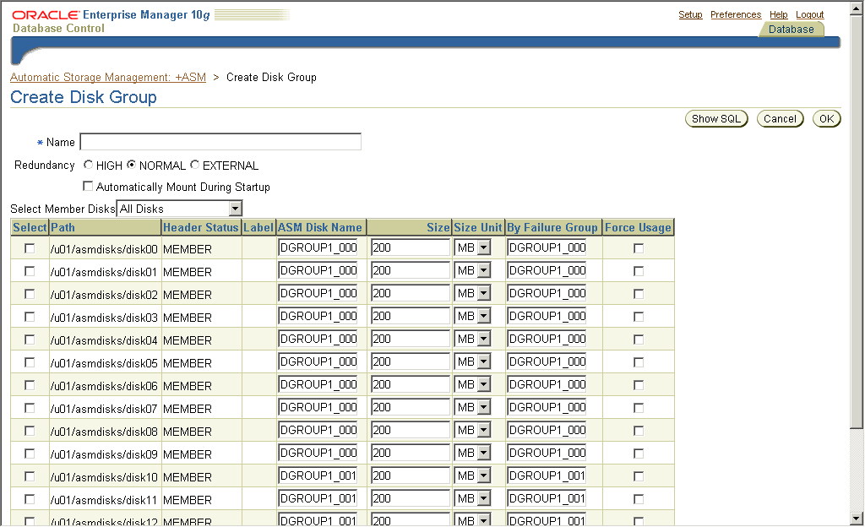
Create Disk Group Page
Notes:
Oracle Database 10g: Administration Workshop II 12-<number>
Create Disk Group Page
Clicking Create on the Disk Group Overview page displays the Create Disk Group page. You can enter the disk group name, redundancy mechanism, and the list of disks that you would like to include in the new disk group.
The list of disks is obtained from the V$ASM_DISK fixed view. By default, only the disks that can be assigned to a disk group show up. Those are the ones with a status of one of the following:
CANDIDATE: The disk has never been assigned to an ASM disk group.
FORMER: The disk was once assigned to an ASM disk group, but is not now.
PROVISIONED: ASMLib is being used, and this disk is not yet assigned to a disk group.
Note: ASMLib is an API that interfaces with other vendors’ storage arrays. See the Database Administrator’s Guide documentation for more information about ASMLib.

Slide 31
Creating and Dropping Disk Groups
CREATE DISKGROUP dgroupA NORMAL REDUNDANCY
FAILGROUP controller1 DISK
'/devices/A1' NAME diskA1 SIZE 120G FORCE,
'/devices/A2',
'/devices/A3'
FAILGROUP controller2 DISK
'/devices/B1',
'/devices/B2',
'/devices/B3';
DROP DISKGROUP dgroupA INCLUDING CONTENTS;
Notes:
Oracle Database 10g: Administration Workshop II 12-<number>
Creating and Dropping Disk Groups
Assume that ASM disk discovery identified the following disks in the /devices directory: A1, A2, A3, B1, B2, and B3. Also, assume that disks A1, A2, and A3 are on a separate SCSI controller from disks B1, B2, and B3. The first example in the slide illustrates how to configure a disk group called DGROUPA with two failure groups: CONTROLLER1 and CONTROLLER2.
The example also uses the default redundancy characteristic, NORMAL REDUNDANCY, for the disk group. You can optionally provide a disk name and size for the disk. If you do not supply this information, ASM creates a default name and attempts to determine the size of the disk. If the size cannot be determined, an error is returned. FORCE indicates that a specified disk should be added to the specified disk group even though the disk is already formatted as a member of an ASM disk group. Using the FORCE option for a disk that is not formatted as a member of an ASM disk group returns an error.
As shown by the second statement in the slide, you can delete a disk group along with all its files. To avoid accidental deletions, the INCLUDING CONTENTS option must be specified if the disk group still contains any files besides internal ASM metadata. The disk group must be mounted in order for it to be dropped. After ensuring that none of the disk group files are open, the group and all its drives are removed from the disk group. Then the header of each disk is overwritten to eliminate the ASM formatting information.

Slide 32
Adding Disks to Disk Groups
ALTER DISKGROUP dgroupA ADD DISK
'/dev/rdsk/c0t4d0s2' NAME A5,
'/dev/rdsk/c0t5d0s2' NAME A6,
'/dev/rdsk/c0t6d0s2' NAME A7,
'/dev/rdsk/c0t7d0s2' NAME A8;
ALTER DISKGROUP dgroupA ADD DISK '/devices/A*';
Disk formatting
Disk group rebalancing
Notes:
Oracle Database 10g: Administration Workshop II 12-<number>
Adding Disks to Disk Groups
This example shows how to add disks to a disk group. You execute an ALTER DISKGROUP ADD DISK command to add the disks. The first statement adds four new disks to the DGROUPA disk group.
The second statement demonstrates the interactions of discovery strings. Consider the following configuration:
/devices/A1 is a member of disk group DGROUPA.
/devices/A2 is a member of disk group DGROUPA.
/devices/A3 is a member of disk group DGROUPA.
/devices/A4 is a candidate disk.
The second command adds A4 to the DGROUPA disk group. It ignores the other disks, even though they match the discovery string, because they are already part of the DGROUPA disk group. As shown by the diagram, when you add a disk to a disk group, the ASM instance ensures that the disk is addressable and usable. The disk is then formatted and rebalanced. The rebalance process is time consuming because it moves AUs from every file onto the new disk.

Slide 33
Miscellaneous ALTER Commands
Remove a disk from dgroupA:
ALTER DISKGROUP dgroupA DROP DISK A5;
Add and drop a disk in a single command:
ALTER DISKGROUP dgroupA
DROP DISK A6
ADD FAILGROUP fred
DISK '/dev/rdsk/c0t8d0s2' NAME A9;
Cancel a disk drop operation:
ALTER DISKGROUP dgroupA UNDROP DISKS;
Notes:
Oracle Database 10g: Administration Workshop II 12-<number>
Miscellaneous ALTER Commands
The first statement in the slide shows how to remove one of the disks from the DGROUPA disk group. The second statement shows how you can add and drop a disk in a single command. The big advantage in this case is that rebalancing is not started until the command completes. The third statement shows how to cancel a disk drop operation. The UNDROP command operates only on pending drops of disks; it has no effect on drops that have completed.
The following statement rebalances the DGROUPB disk group, if necessary:
ALTER DISKGROUP dgroupB REBALANCE POWER 5;
This command is generally not necessary because it is automatically done as disks are added, dropped, or resized. However, it is useful if you want to use the POWER clause to override the default speed defined by the initialization parameter ASM_POWER_LIMIT. You can change the power level of an ongoing rebalance operation by reentering the command with a new level. A power level of zero causes rebalancing to halt until the command is either implicitly or explicitly reinvoked.
The following statement dismounts DGROUPA:
ALTER DISKGROUP dgroupA DISMOUNT;
The MOUNT and DISMOUNT options allow you to make one or more disk groups available or unavailable to the database instances.

Slide 34

ASM Files
CREATE TABLESPACE sample DATAFILE '+dgroupA';
Database file
RMAN
1
Automatic
ASM file
creation
2
3
4
1
2
3
4
ASM file automatically spread inside disk group dgroupA
Notes:
Oracle Database 10g: Administration Workshop II 12-<number>
ASM Files
When you specify an ASM disk group as the data file name for a tablespace, ASM files are created in the disk group to provide storage for the tablespace.
When an ASM file is created, certain file attributes are permanently set. Among these are its protection policy, and its striping policy. ASM files are Oracle Managed Files. Any file that is created by ASM is automatically deleted when it is no longer needed.
With ASM, file operations are specified in terms of database objects. Administration of databases never requires knowing the name of a file, though the name of the file is exposed through some data dictionary views, or the ALTER DATABASE BACKUP CONTROLFILE TO TRACE command. Because each file in a disk group is physically spread across all disks in the disk group, a backup of a single disk is not useful. Database backups of ASM files must be made with RMAN.
Note: ASM does not manage binaries, alert logs, trace files, or password files.

Slide 35
ASMCMD Utility
SQL> CREATE TABLESPACE tbsasm DATAFILE '+DGROUP1' SIZE 100M;
Tablespace created.
SQL> CREATE TABLESPACE hrapps DATAFILE '+DGROUP1' SIZE 10M;
Tablespace created.
$ asmcmd
ASMCMD> ls -l DGROUP1/ORCL/DATAFILE
Type Redund Striped Time Sys Name
DATAFILE MIRROR COARSE OCT 05 21:00:00 Y HRAPPS.257.570923611
DATAFILE MIRROR COARSE OCT 05 21:00:00 Y TBSASM.256.570922917
ASMCMD>
Notes:
Oracle Database 10g: Administration Workshop II 12-<number>
ASMCMD Utility
ASMCMD is a command-line utility that you can use to easily view and manipulate files and directories within ASM disk groups. It can list the contents of disk groups, perform searches, create and remove directories, and display space utilization, among other things.
Note: For more information about ASMCMD, see the Oracle Database Utilities documentation.

Slide 36
Миграция БД в to ASM Storage
  1.Останавливаем БД.
  2. Меняем параметры.
  3. запускаем RMAN скрипт:
STARTUP NOMOUNT;
RESTORE CONTROLFILE FROM '/u1/c1.ctl';
ALTER DATABASE MOUNT;
BACKUP AS COPY DATABASE FORMAT '+dgroup1';
SWITCH DATABASE TO COPY;
SQL "ALTER DATABASE RENAME '/u1/log1' TO '+dgroup1' ";
# Repeat RENAME command for all online redo log members ...
ALTER DATABASE OPEN RESETLOGS;
SQL "ALTER DATABASE TEMPFILE '/u1/temp1' DROP";
Notes:
Oracle Database 10g: Administration Workshop II 12-<number>
Migrating Your Database to ASM Storage
Because ASM files cannot be accessed through normal operating system interfaces, RMAN is the only means for copying ASM files. Although files in a tablespace may be both ASM files and non-ASM files as a result of the tablespace history, RMAN commands enable non-ASM files to be relocated to an ASM disk group. You can use the following procedure to relocate your entire database to an ASM disk group: (It is assumed that you are using a server parameter file.)
1. Obtain the file names of the current control files and online redo logs by using V$CONTROLFILE and V$LOGFILE.
2. Shut down the database consistently. Modify the server parameter file of your database as follows:
Set the necessary OMF destination parameters to the desired ASM disk group.
Remove the CONTROL_FILES parameter.

Slide 37
Дисковые группы
set pages 40000 lines 120
column NAME for a15
select group_number dg#, name, allocation_unit_size au_sz, state, type,
total_mb, free_mb, offline_disks
from v$asm_diskgroup;
DG# NAME AU_SZ STATE TYPE TOTAL_MB FREE_MB OFFLINE_DISKS
--- ----- ------- -------- ------ ------ ------- -------------
1 DATA2 4194304 MOUNTED NORMAL 40952 4168 0
2 DATA 1048576 MOUNTED NORMAL 30717 25667 0

Slide 38
Диски дисковых групп
set lines 160;
column name format a15;
column path format a26;
column failgroup format a10;
select name, group_number, disk_number, failgroup, mount_status, header_status, mode_status, state, redundancy, path
from v$asm_disk
order by group_number;
NAME GROUP_NUM DISK_NUM MOUNT_S HEADER_ST MSTATE PATH
------------- --------- -------- ------- --------- ------- -------------------------
0 2 CLOSED MEMBER ONORMAL /dev/ora_asmspfile_raw_5m
OLTPGRP1_0002 1 2 CACHED MEMBER ONORMAL /dev/ora_asm3_raw_20g
OLTPGRP1_0003 1 3 CACHED MEMBER ONORMAL /dev/ora_asm4_raw_20g
OLTPGRP1_0000 1 0 CACHED MEMBER ONORMAL /dev/ora_asm2_raw_10g
OLTP_DISK1 1 1 CACHED MEMBER ONORMAL /dev/ora_asm1_raw_10g

Slide 39
MOUNT_STATUS
MISSING — диск известен как часть дисковой группы ASM, но в дисковой системе диск с таким именем отсутствует.
CLOSED — диск присутствует в системе хранения, но является не доступным для ASM.
OPENED — диск присутствует в системе хранения и доступен для ASM. Нормальное состояние дисков, являющихся частью дисковой группы, активно используемой экземпляром.
CACHED (по умолчанию) — диск присутствует в системе хранения и доступен для ASM. Нормальное состояние дисков ASM, которые являются частью смонтированной дисковой группы.
IGNORED — диск присутствует в системе, однако игнорируется ASM под одной из следующих причин:
диск определен системной библиотекой, но игнорируется, поскольку библиотека ASM нашла тот же диск.
ASM определила, что членство, указанное в заголовке, не является действительным.
CLOSING — ASM находится в процессе закрытия диска.

Slide 40
HEADER_STATUS
UNKNOWN — заголовок диска ASM не был прочитан.
CANDIDATE — диск не является членом дисковой группы и может быть добавлен в дисковую группу командой ALTER DISKGROUP.
INCOMPATIBLE — версия в заголовке диска не совместима с версией ASM.
PROVISIONED — диск не является членом дисковой группы и может быть добавлен в дисковую группу командой ALTER DISKGROUP. Статус заголовка PROVISIONED отличается от статуса CANDIDATE тем, что статус PROVISIONED предполагает, что дополнительные, зависящие от платформы, действия должны быть предприняты для того, чтобы сделать диск доступным для ASM.
MEMBER (по умолчанию) — диск является членом дисковой группы. К таким дискам не должны предприниматься попытки добавление такого диска в другую дисковую группу. Команда ALTER DISKGROUP будет отклонена, кроме случаев использования опции FORCE.
FORMER — ранее диск был членом дисковой группы и был правильно удален из нее. Может быть добавлен в новую дисковую группу командой ALTER DISKGROUP.
CONFLICT — диск ASM не смонтирован из-за конфликта.
FOREIGN — диск содержит данные, созданные иными чем ASM продуктами Oracle. Это могут быть файлы данных, логов или OCR диски.

Slide 41
MODE_STATUS
UNKNOWN — статус диска ASM неизвестен (обычно, когда диск не смонтирован).
ONLINE (по умолчанию) — диск в рабочем состоянии и нормально функционирует. Предпринимаются попытки чтения/записи.
OFFLINE — диск в неактивном состоянии, и доступ к данным не разрешен. Попытки чтения/записи не предпринимаются. Отключенный диск логически является частью дисковой группы.

Slide 42
STATE
• UNKNOWN — статус ASM диска не известен (обычно, когда диск не смонтирован)
• NORMAL (по умолчанию) — диск в рабочем состоянии и нормально функционирует.
• ADDING — диск в процессе добавления в дисковую группу и завершает процедуру проверки монтирования всеми экземплярами.
• DROPPING — диск вручную выводится в неактивное состояние, размещение или доступ к данным прекращен. Начинается процесс перераспределения для перемещения данных из данного диска на остальные диски дисковой группы. По завершению перераспределения диск будет исключен из дисковой группы.
• HUNG — операция удаления диска прекращена поскольку недостаточно дискового пространства для перемещения данных с удаляемого диска на другие диски группы.
• FORCING — диск удаляется из дисковой группы без попыток переноса данных с него. Данные по возможности будут восстановлены с избыточных копий.
• DROPPED — диск полностью исключен из дисковой группы.
• OFFLINE — диск находится в неактивном состоянии, и доступ к данным не разрешен. Попытки чтения/записи не предпринимаются. Отключенный диск логически является частью дисковой группы.

Slide 43
Использование дискового пространства
set lines 100;
column name format a15;
select name, group_number, disk_number, total_mb, free_mb
from v$asm_disk
order by group_number;
NAME GROUP_NUMBER DISK_NUMBER TOTAL_MB FREE_MB
--------------- ------------ ----------- ---------- ----------
0 2 0 0
OLTPGRP1_0002 1 2 20480 5899
OLTPGRP1_0003 1 3 20480 6037
OLTPGRP1_0000 1 0 10240 3059
OLTP_DISK1 1 1 10240 3065

Slide 44
Файлы в ASM
select a.name, f.bytes, f.type
from v@asm_alias a, v$asm_file f
where f.file_number = a.file_number;
select concat('+' || gname, sys_connect_by_path(aname, '/')) full_alias_path, system_created, alias_directory, file_type
from (select b.name gname, a.parent_index pindex, a.name aname,
a.reference_index rindex, a.system_created,
a.alias_direstory, c.type file_type
from v$asm_alias a, v$asm_diskgroup b, v$asm_file c
where a.group_number = b.group_number and
a.group_number = c.group_number (+) and
a.file_number = c.file_number (+) and
a.file_incarnation = c.file_incarnation (+)
)
start with (mod(pindex, power(2, 24))) = 0
connect by prior rindex = pindex;

Slide 45
Добавить диск в дисковую группу
alter diskgroup data1
add disk '/dev/raw/raw4';

Slide 46
Удалить дисковую группу
drop diskgroup '<имя дисковой группы>';

